Slide 1


ENCONTRANDO O MELHOR CAMINHO PARA O CALENDARIO F1 2023
Reinforcement Learning
TSP
Um apelo para a volta do motor V8

Slide 2






TSP

Slide 3
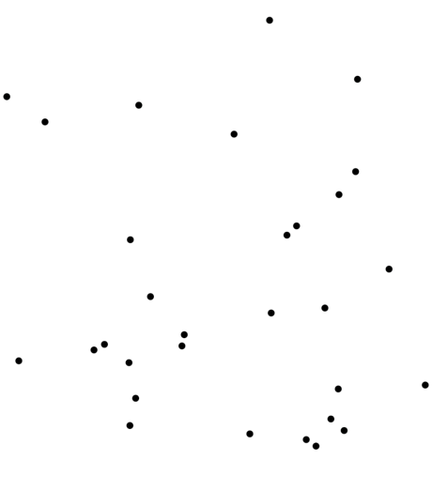
TSP Euclidiano

Slide 4




Complexidade
$$P=\frac{\left(n−1\right)!}{2}$$
$$O(n!)$$
$$np−hard$$

Slide 5



Slide 6

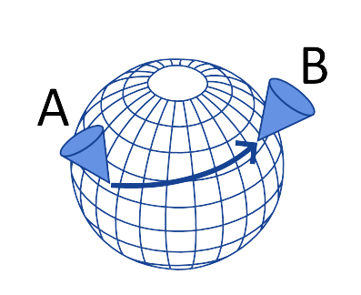
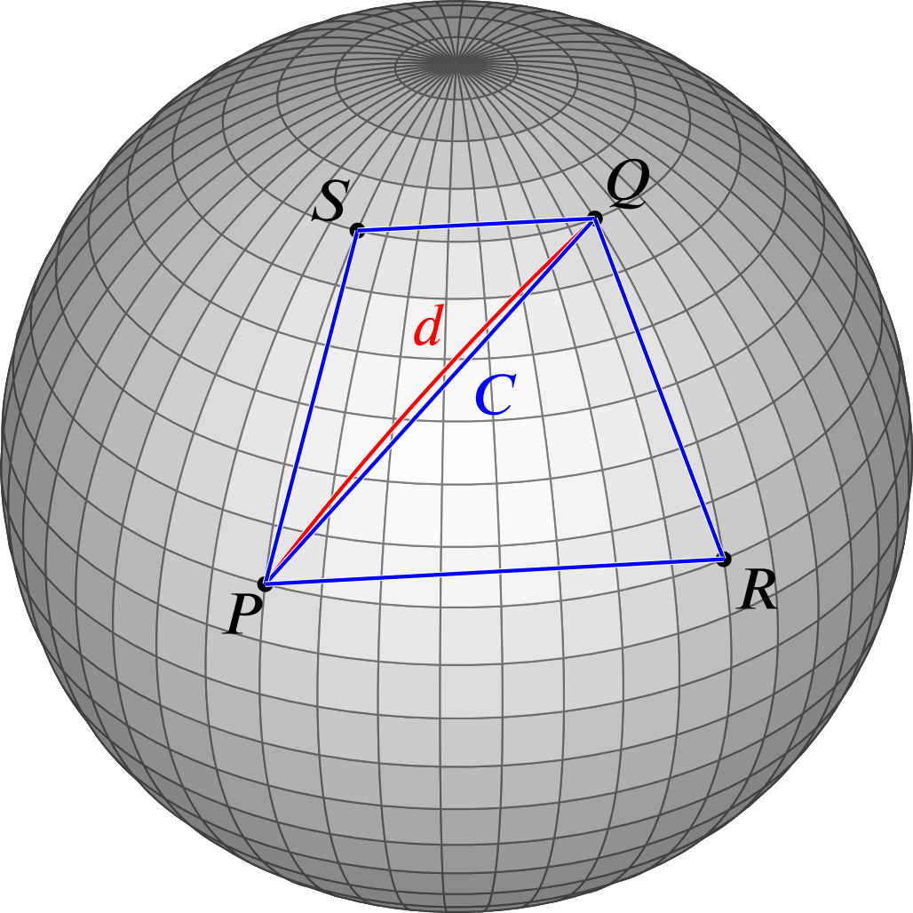
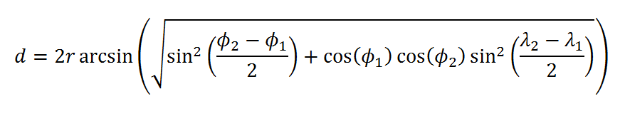
Modelagem
Haversine

Slide 7

O problema: TSP para F1 2023
AVALIANDO ESTATISTICAS DA POLITICA ATUAL
23 GPs
9,516,888 L
132,179 Km
U$ 8,296,520.16
6 Boeing 747 cargo
24,133,876 Kg ${CO}_{2}$

Slide 8
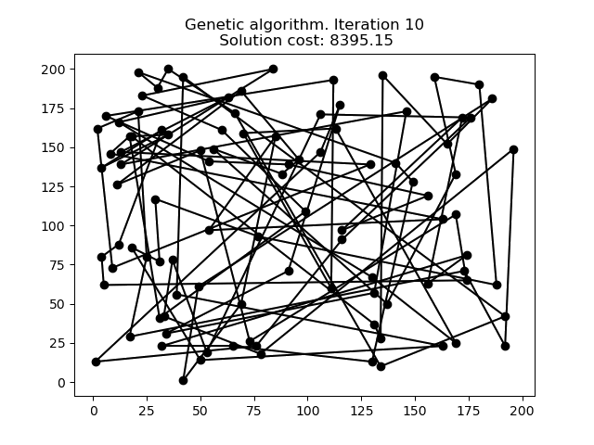




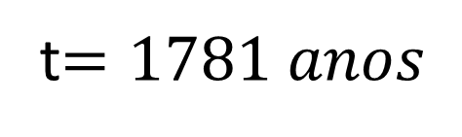
Dimensões
$$P=\frac{\left(n−1\right)!}{2}=5.62×{10}^{20}$$
$$P=\frac{\left(n−1\right)!}{2}$$
$$P=562,000,363,888,803,840,000$$
$$O(n!)$$
t$=1781 anos$
$$np−hard$$

Slide 9

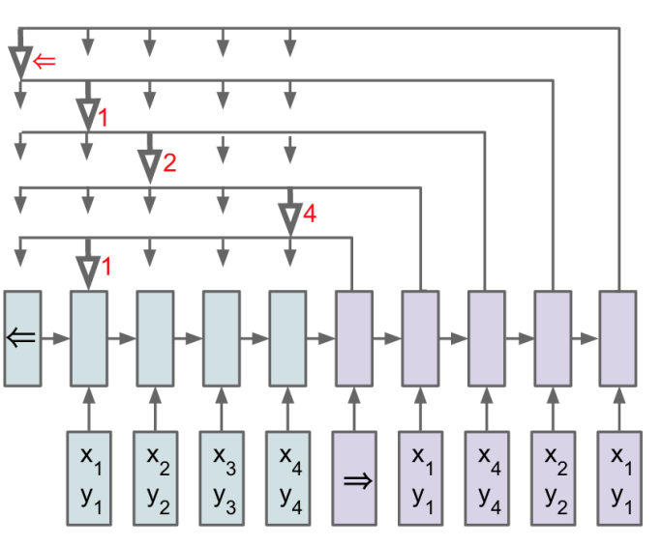
Pointer Network
REINFORCE
start_idx = 0
state = [[1, 1], [1, 2], [2, 2], [2, 1]]
Actions = []
for _ in sequence_length:
scores = p_network(states, start_idx)
scores = mask(scores) [-0.4, -0.1, 0.3, 0.9]
probs = softmax(scores) [0.1245, 0.1680, 0.2507, 0.4568]
selected_action = probs.sample()
start_idx = selected_action
actions.append(selected_action)

Slide 10
Pointer Network
REINFORCE
start_idx = 0
state = [[1, 1], [1, 2], [2, 2], [2, 1]]
Actions = []
for _ in sequence_length:
scores = p_network(states, start_idx)
scores = mask(scores) [-0.4, -0.1, 0.3, -inf]
probs = softmax(scores) [0.2292, 0.3093, 0.4615, 0]
selected_action = probs.sample()
start_idx = selected_action
actions.append(selected_action)

Slide 11
Pointer Network
REINFORCE
start_idx = 0
state = [[1, 1], [1, 2], [2, 2], [2, 1]]
Actions = []
for _ in sequence_length:
scores = p_network(states, start_idx)
scores = mask(scores) [-0.4, -0.1, -inf, -inf]
probs = softmax(scores) [0.4256, 0.5744, 0, 0]
selected_action = probs.sample()
start_idx = selected_action
actions.append(selected_action)

Slide 12
Pointer Network
REINFORCE
start_idx = 0
state = [[1, 1], [1, 2], [2, 2], [2, 1]]
Actions = []
for _ in sequence_length:
scores = p_network(states, start_idx)
scores = mask(scores) [-0.4, -inf, -inf, -inf]
probs = softmax(scores) [1, 0, 0, 0]
selected_action = probs.sample()
start_idx = selected_action
actions.append(selected_action)

Slide 13

Heurística
Nearest Neighbor

Slide 14

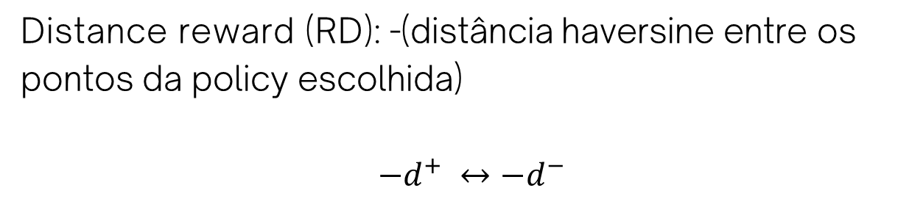
Reward
Engeneering
R = DR*DW + HR*HW
Distance reward (RD): -(distância haversine entre os pontos da policy escolhida)
$$−d^{+} ↔−d^{−}$$
Distance_weight (DW): 0 -> 1 linearmente durante os 100000 primeiros episódios.
Heuristic reward (HD): Uma medida do quão parecido a política atual é com a heuristica.
$−200 ↔−100$
Heuristic_weight (HW): 1 -> 0 linearmente durante os 100000 primeiros episódios.

Slide 15
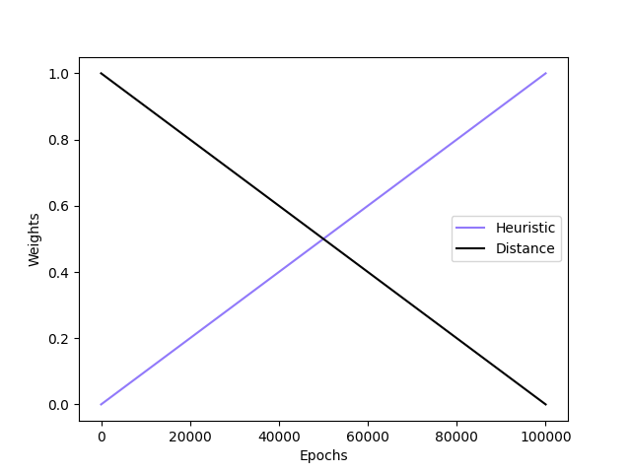
R = DR*DW + HR*HW
Distance
Heuristics

Slide 16

Pointer Network
REINFORCE
Held-Karp
Algorithm
Não garante política ótima
Garante a poIitica ótima
Complexidade desconhecida
$$O(2^{n}n^{2})$$
Factivel para valores n = 100-1000
Factivel para $n=23$

Slide 17
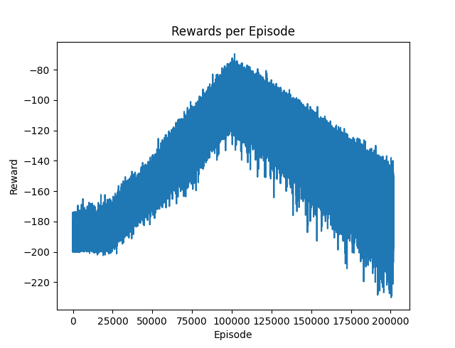
Resultados
69,726 Km (12%)
62,142 Km
17 HORAS DE TREINAMENTO
REINFORCE (53%)
Held-Karp (47%)

Slide 19

O problema: TSP para F1 2023
AVALIANDO ESTATISTICAS DA POLITICA OTIMA
23 GPs
4,474,224 L
62,142 Km
U$ 3,900,486
6 Boeing 747 cargo
11,346,185 Kg ${CO}_{2}$

Slide 20






Apéndice
Crédito: 12,787,691 Kg ${CO}_{2}$
V6
Turbo-Hybrid
Livre
Livre
V10
V8
1950
1980
1995
2006
2014
230 kg
105,800 kg
327,554 Kg ${CO}_{2}$
220 kg
101,200 kg
313,313 kg ${CO}_{2}$
110 kg
50,600 kg
156,656 kg ${CO}_{2}$
156.657 kg ${CO}_{2}$

Slide 21

Aberto
para perguntas!

